Slide 1
GaussianMarker: Uncertainty-Aware Copyright Protection of 3D Gaussian Splatting
Source: Conference on Neural Information Processing System(NeurIPS, 2024).
Author: Xiufeng Huang, Ruiqi Li, Yiu-ming Cheung, Ka Chun Cheung, Simon See, Renjie Wan
Speaker: Hengxiao Chi
Date: 2024/12/18

Slide 2
Outline
Introduction
3DGS
Proposed scheme
Experiments
Conclusions

Slide 3
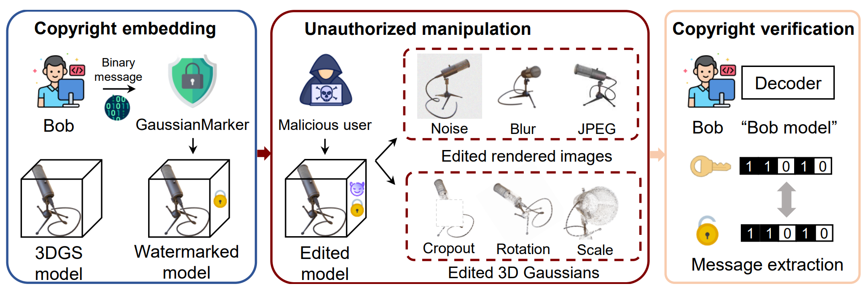
Introduction

Slide 4
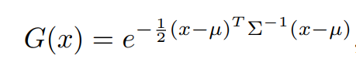
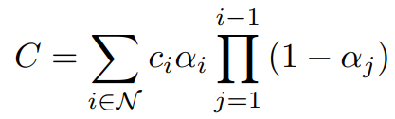
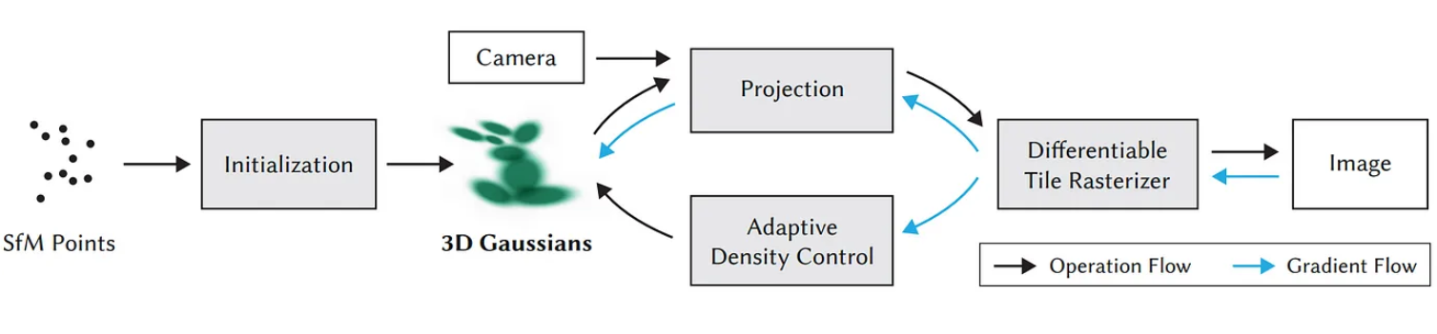
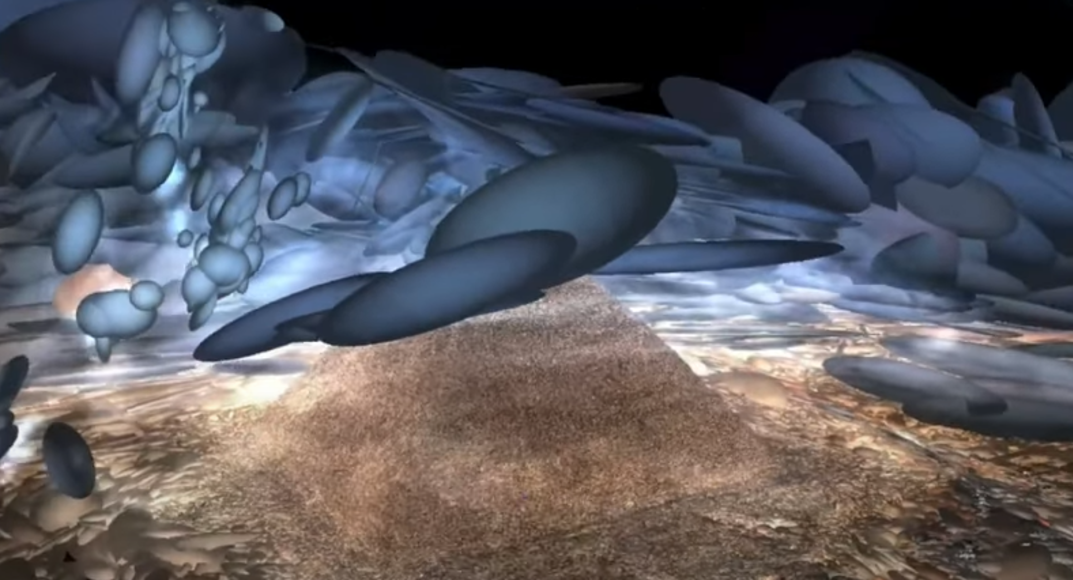
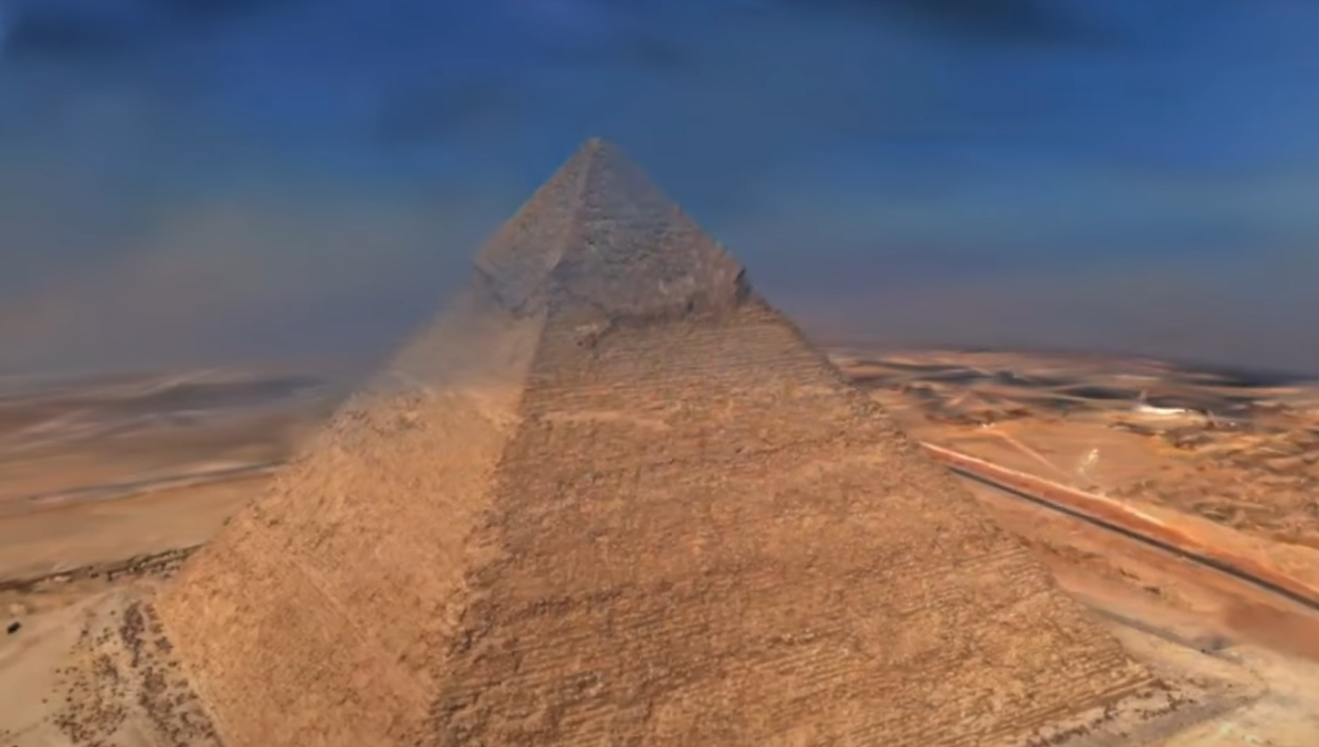
3DGS

Slide 5
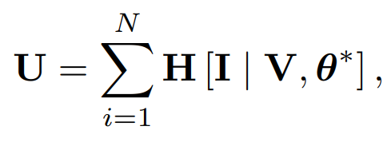

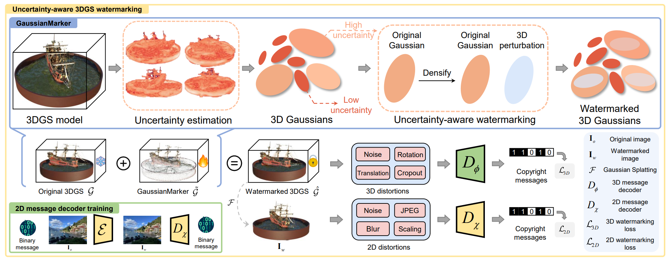


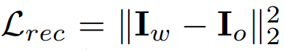


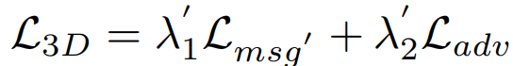
Proposed scheme(1/2)

Slide 6
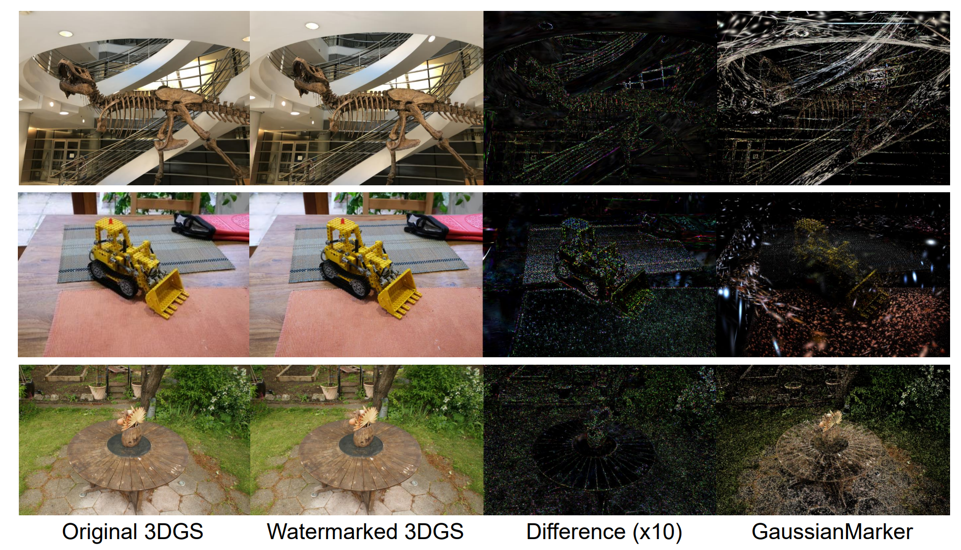
Proposed scheme(2/2)

Slide 7
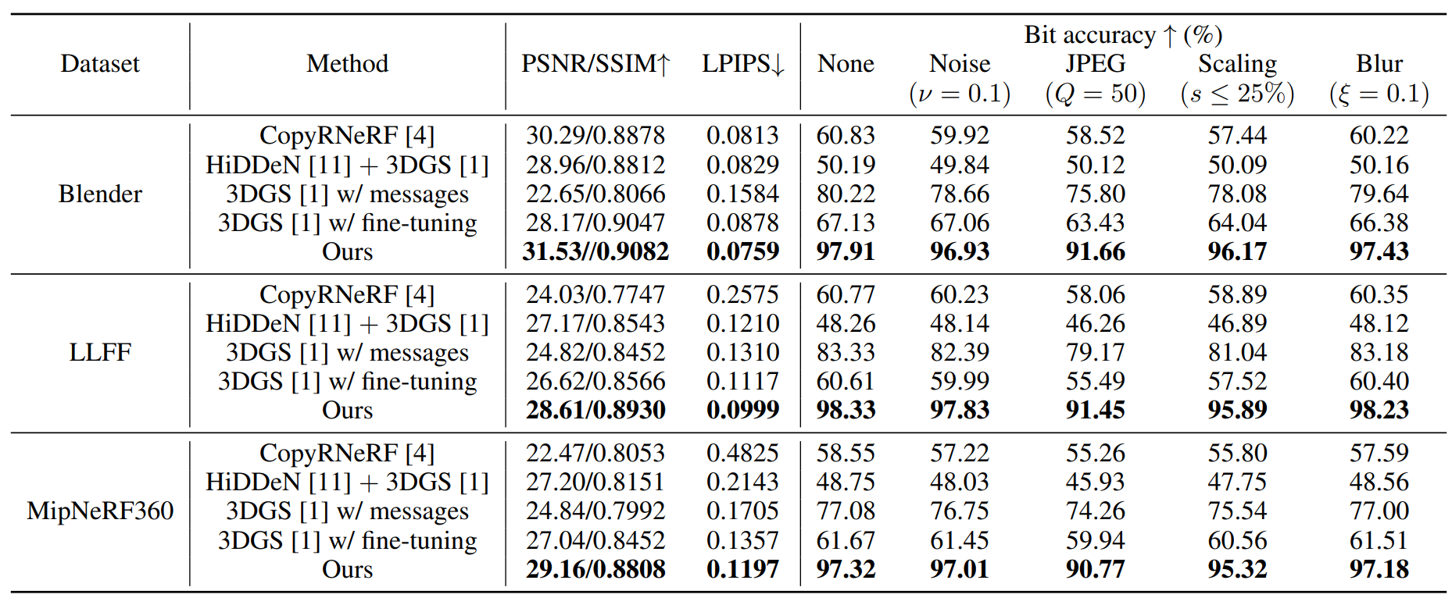
Experiments(1/3)
Learned Perceptual Image Patch Similarity

Slide 8
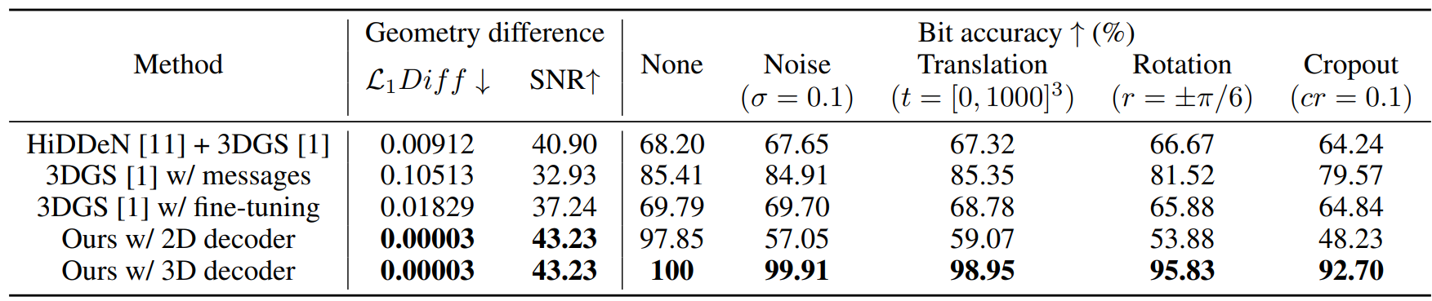
Experiments(2/3)
signal-to-noise ratio (SNR)

Slide 9
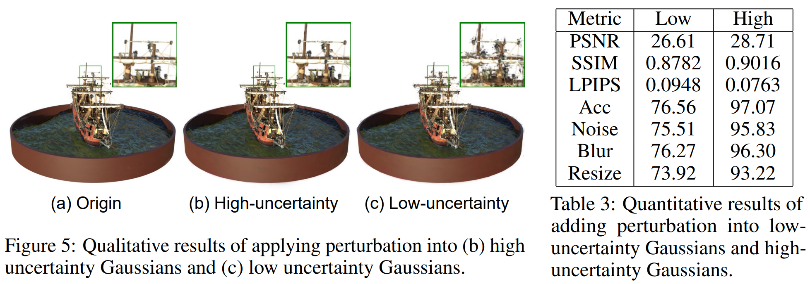
Experiments(3/3)

Slide 10
Conclusions
The uncertainty of 3D Gaussian parameters is exploited.
The invisibility of watermark.
Robustness

